Slide 1
SURICATA with DPDK & HW offload – session-1
How to run smartly for IDS|IPS on edge, cloud or bare metal for performance and efficiency?

Slide 2
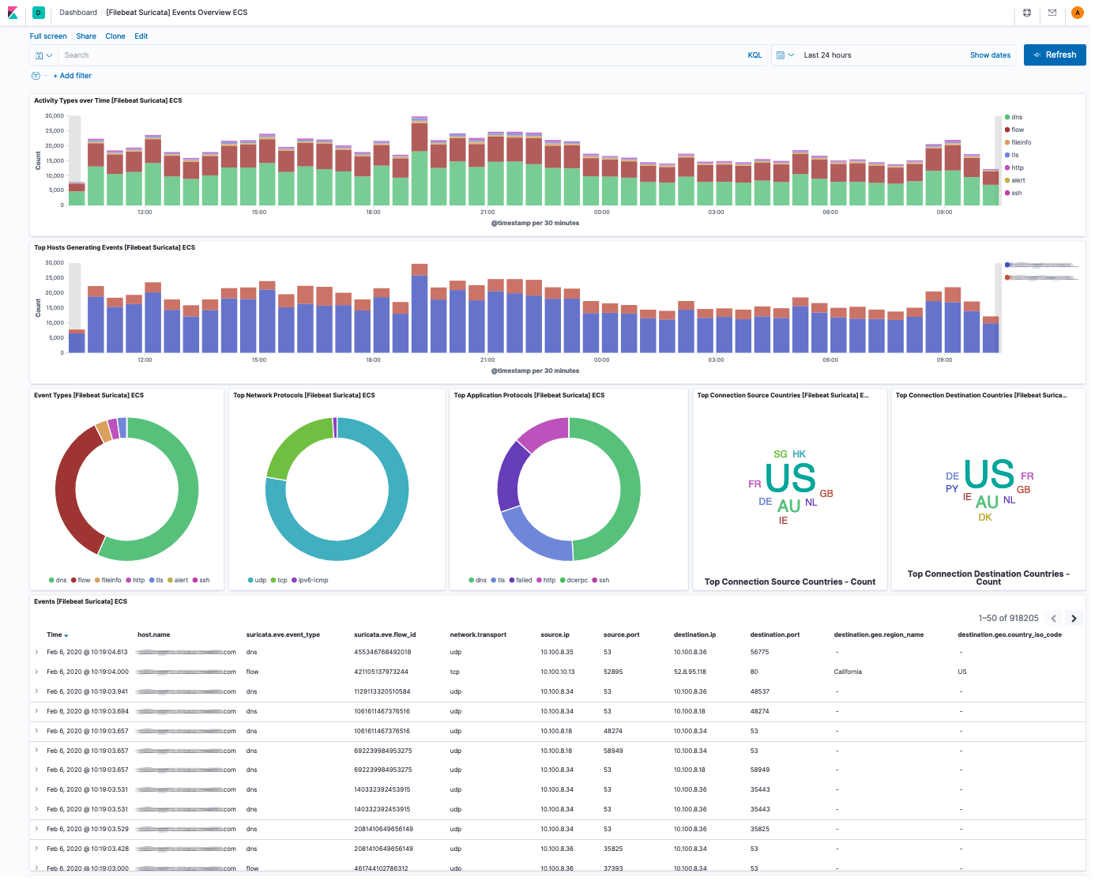
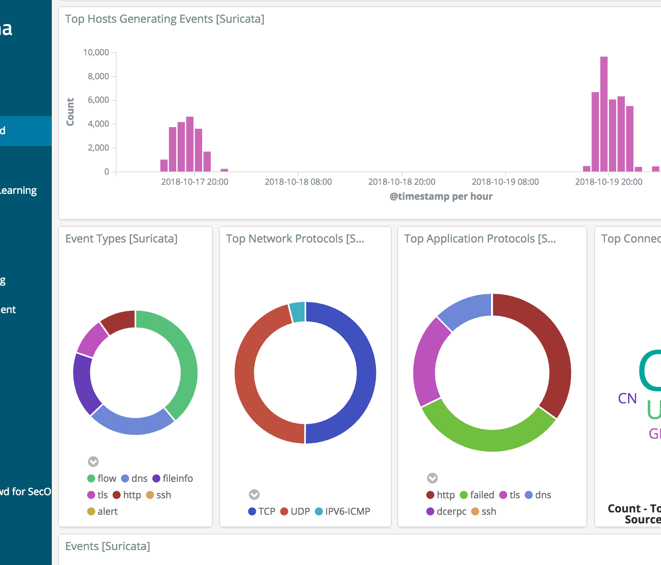
What is Firewall for us!

Slide 3
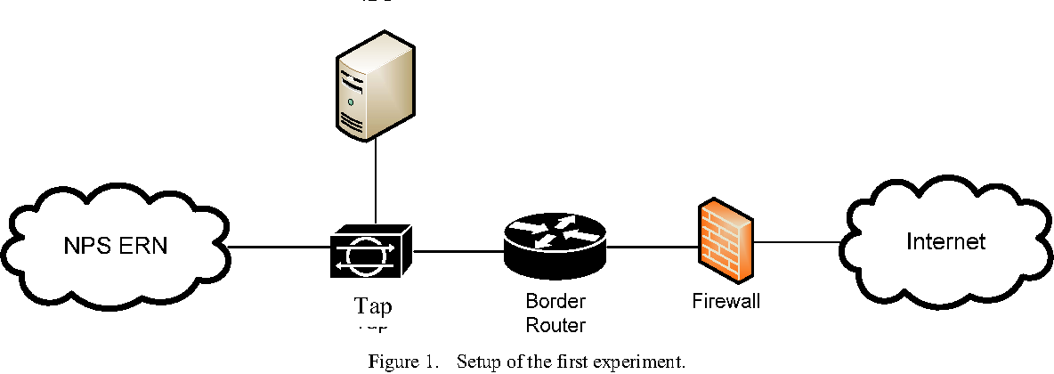
How does it work today?

Slide 4
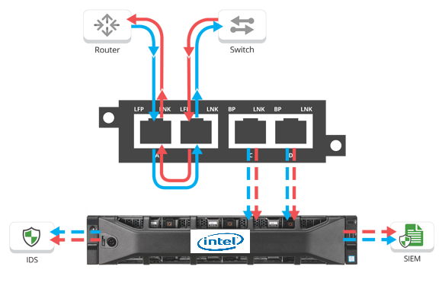
Create TAP allow mirroring of packets from desired direction Ingress/Egress
In case of IDS mirror traffic.
In case of IPS redirect to Inspection Engine
In case of BYPASS, simply allow port Forwarding

Slide 5
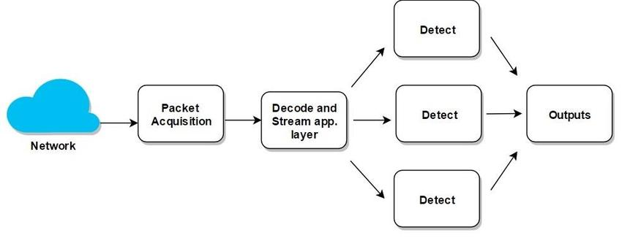
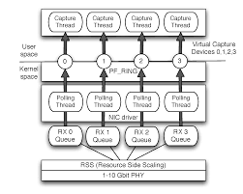
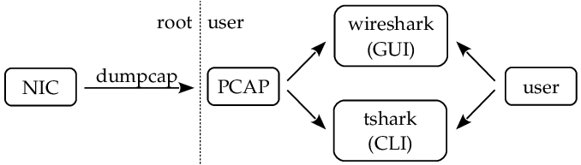
Capture methods

Slide 6
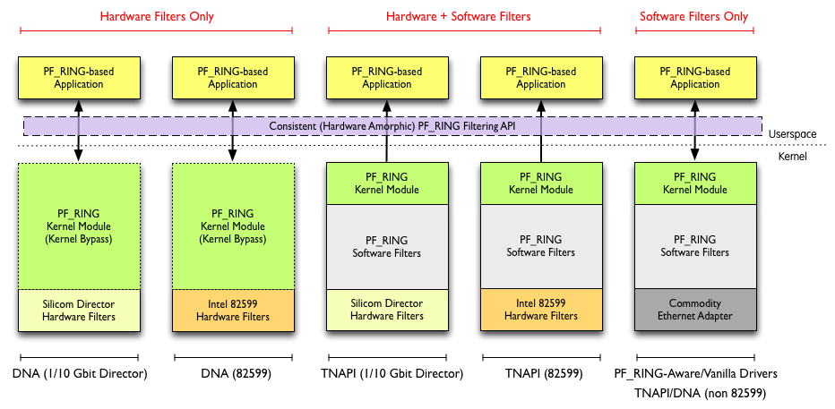
ALTERNATIVE APPROACHES?
PF_RING alternative with HW or SW offload.
Similar functionality can be achieved with XDP and eBPF.

Slide 7
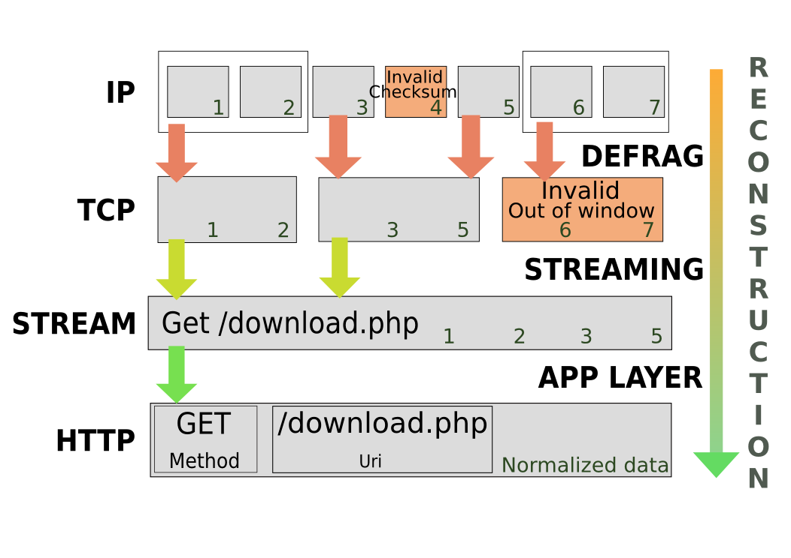
Inspection Engine – does before inspecting

Slide 8
references
https://www.stamus-networks.com/blog/2016/09/28/suricata-bypass-feature
https://home.regit.org/2012/07/suricata-to-10gbps-and-beyond/
https://suricata.readthedocs.io/en/suricata-4.1.2/setting-up-ipsinline-for-linux.html
https://www.neox-networks.com/en/solutions/suricata-performance-increase/
https://xbu.me/article/performance-characterization-of-suricata-thread-models/
https://www.researchgate.net/figure/Percentage-of-alerts-detected_tbl2_220307667
https://suricon.net/wp-content/uploads/2016/11/SuriCon2016_MichalPurzynsk
https://docs.nubeva.com/en/latest/tools/suricata.htmli_PeterManev.pdf
https://www.wwt.com/lab/napatech-suricata-ids-ips-and-nsm-lab
https://www.hurricanelabs.com/docs/idsguide.pdf

